Slide 1

Mimir: Memory-Efficient and Scalable MapReduce for Large Supercomputing Systems
Tao Gao^{1,2}, Yanfei Guo³, Boyu Zhang¹,
Pietro Cicotti⁴, Yutong Lu^{2,5,6},
Pavan Balaji³, Michela Taufer¹
¹ University of Delaware
² National University of Defense Technology
³ Argonne National Laboratory
⁴ San Diego Supercomputer Center
⁵ National Supercomputer Center in Guangzhou
⁶ Sun Yat-sen University

Slide 2
Data Processing on HPC Systems
Introduction Background Design Evaluation Conclusion
Building MapReduce over MPI is an appealing way to enable efficient big data processing on HPC systems
Key differences between Cloud computing and HPC systems disenfranchise the naïve used of Cloud methods
HPC prefers in-memory processing
Cloud computing systems
HPC systems
disk
processor
processor
Interconnect
Ethernet
processor
disk
array
disk
Hadoop/Spark
1
MPI/OpenMP
Notes:
Processing data on HPC systems is a need today, and MapReduce over MPI is an appealing solution. However, we cannot just go out and apply cloud solutions to HPC, because there are differences between the two.
Key point: "...Cannot simply take cloud frameworks and apply them on HPC systems..."

Slide 3
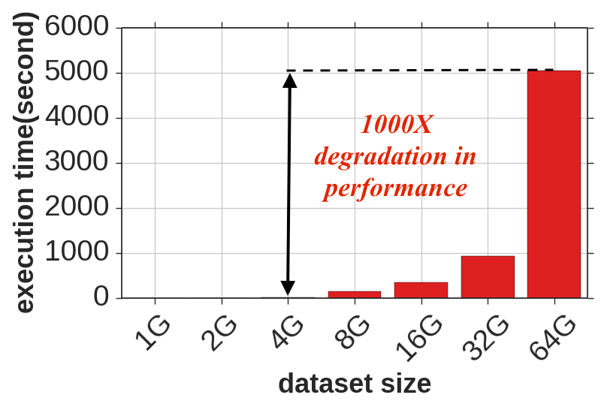
Limits of Existing MapReduce over MPI
Introduction Background Design Evaluation Conclusion
State-of-art MapReduce over MPI is MapReduce-MPI (MR-MPI)
BUT MapReduce-MPI does not use memory efficiently
Can process only 4GB data in-memory on a 128GB node
Out-of-memory
processing
Single-node execution time of WordCount (Wikipedia) with MR-MPI on Comet (128G memory).
2
Notes:
There have been efforts to integrate MapReduce with MPI, and to the best of our knowledge, MapReduce-MPI is the state-of-the-art. Even with a simple benchmark like wordcount, we see the limitations of MapReduce-MPI. Explain that it is a single node execution, the x-axis is ..., on the y-axis is ...., we observed . Once out-of-memory processing begins, the performance decreases rapidly. Starting at 64GB, which is less than the memory of the system, there is a 1000x decrease in performance
Key point: "...Even with a simple benchmark like WordCount, we see the limitations of MapReduce MPI on an HPC system, Comet..." You can emphasize the fact that even with a *small* data set (64 GB) that fits in memory we see a 1000x slowdown

Slide 4
Our Goal and Contributions
Introduction Background Design Evaluation Conclusion
Our goal:
Overcome the memory-inefficiency problem of MR-MPI
Our contributions:
A new MapReduce implementation over MPI, called Mimir, to overcome the memory inefficiency problem of MR-MPI
Results for three benchmarks, four datasets, and two different HPC systems showing that Mimir significantly advances the state of the art with respect to MapReduce over MPI frameworks

Slide 5
MapReduce Programming Model
Introduction Background Design Evaluation Conclusion
Applications provide map and reduce functions
The MapReduce runtime handles the parallel job execution, communication, and data movement.
Wordcount example:
<Hello,1>
Hello
World
<world,1>
reduce
<Hello, 2>
map
Shuffle
Hello
World
map
reduce
<World, 2>
<Hello,1>
<world,1>
Notes:
e applications only need to provide map and reduce, and all of the rest (like communication and data movement) are handled in the background by the runtime. Let me show you the simple example wordcount. This programming model is implemented in MapReduce-MPI

Slide 6
MapReduce-MPI Workflow
Introduction Background Design Evaluation Conclusion
Support logical map-shuffle-reduce workflow in four phases
Map, aggregate, convert, and reduce
Synchronize and stage intermediate data for each phase
input
<key, value>
<key, value>
<key, list<value>>
output
P0
aggregate
convert
reduce
map
P1
map
convert
reduce
…
…
…
…
…
Pn
map
convert
reduce
barrier
barrier
barrier
barrier
Shortcomings: 1. Extra synchronization

Slide 7
Intermediate Data Management
Introduction Background Design Evaluation Conclusion
Zoom in map and aggregate phases
zoom in
input
<key,value>
<key,value>
<key,list<value>>
output
P0
aggregate
convert
map
reduce
P1
map
convert
reduce
…
…
…
…
…
Pn
map
convert
reduce
Shortcomings: 2. Extra data staging
Notes:
I want also to point out how MapReduce-MPI works with intermediate data management, so I zoom in to show you how it works

Slide 8
Intermediate Data Management
Introduction Background Design Evaluation Conclusion
Each staging area has one in-memory buffer (called page)
If the page is full → MR-MPI spills data to the disk
Static
Allocation
staging area
staging area
send buffer
receive buffer
P0
map
send buffer
receive buffer
P1
map
Shortcomings: 3. Extra memory use; 4. Inefficient data management
Notes:
First it needs to allocation additional memory for metadata, then the information is copied to the send buffer, transferred to the recieve buffer, and copied into the staging area

Slide 9
Summary of Shortcomings of MR-MPI
Introduction Background Design Evaluation Conclusion
Use extra synchronization
Use extra data staging
Use extra memory
Manage intermediate data inefficiently

Slide 10
Redefining the MR Workflow
Introduction Background Design Evaluation Conclusion
Map is interleaved with aggregate in Mimir
interleave
input
<key, value>
<key,value>
<key,list<value>>
output
P0
aggregate
convert
reduce
map
P1
map
convert
reduce
…
…
…
…
…
Pn
map
convert
reduce
barrier
barrier
barrier
barrier
Improvements: 1. Reduce synchronization; 2. Reduce extra data staging

Slide 11
Optimizing Intermediate Data Management
Introduction Background Design Evaluation Conclusion
Map is interleaved with aggregate in Mimir
interleave
<key, value>
<key, list<value>>
output
input
P0
aggregate
convert
reduce
map
P1
map
convert
reduce
…
…
…
…
Pn
map
convert
reduce
10

Slide 12
Optimizing Intermediate Data Management
Introduction Background Design Evaluation Conclusion
Use send buffer as output of map directly
Avoid extra buffers usage
Use KV/KMV container as staging area
Dynamically allocate one or multiple pages
Dynamic
Allocation
KV container
Improvements:
3. Avoid extra memory buffer usage;
4. Manage intermediate data more efficiently
P0
map
P1
map

Slide 13
Instructing Compression and Partial-Reduction
Introduction Background Design Evaluation Conclusion
Compression: merge <key,value> pairs with the same key before shuffle
Partial-reduction:merge <key,value> pairs with the same key after shuffle
Wordcount example:
Hello
World
Hi
World
<Hello,1>
<World,1>
reduce
<Hello, 3>
map
<World,2>
<Hello,2>
<Hi,1>
<World,1>
Hello
World
Shuffle
<Hello,1>
map
reduce
<World, 3>
<World,1>
Hello
reduce
<Hi, 1>
map
<Hello,1>

Slide 14
Instructing Compression and Partial-Reduction
Introduction Background Design Evaluation Conclusion
Compression and partial-reduction algorithms
Takes two <key,value> pairs as input and make one <key,value> pair
interleave
<key, value>
<key, list<value>>
output
<key, value>
input
P0
aggregate
convert
reduce
map
compress
partial-reduce
P1
map
convert
reduce
compress
partial-reduce
…
…
…
…
…
Pn
map
convert
reduce
compress
partial-reduce
Improvements: 4. Manage intermediate data more efficiently

Slide 15
KV-Hint Optimization
Introduction Background Design Evaluation Conclusion
Use key and value type information to reduce storage size of <key,value>
<key,value> storage without kv-hint
key size
value size
key
value
<key,value> storage with kv-hint
key
value
Improvement: 4. Manage intermediate data more efficiently
Notes:
This look empty!!! Add an arrow

Slide 16
Experimental Setting
Introduction Background Design Evaluation Conclusion
Platforms and settings
Comet (SDSC): 128GB memory/node; 24 cores/node; InfiniBand; Lustre
Mira (ANL): 16GB memory/node; 16 cores/node; 5D-torus; GPFS
MPI: MPICH 3.2
Benchmarks and Datasets
Wordcount (WC): Wikipedia data and synthetic data
BFS: data generated by Graph500 benchmark
Octree Clustering (OC): synthetic 3D points
Metrics
Peak memory usage per process
Execution time
Focus on in-memory processing
Wikipedia datasets: https://engineering.purdue.edu/~puma/datasets.htm

Slide 17
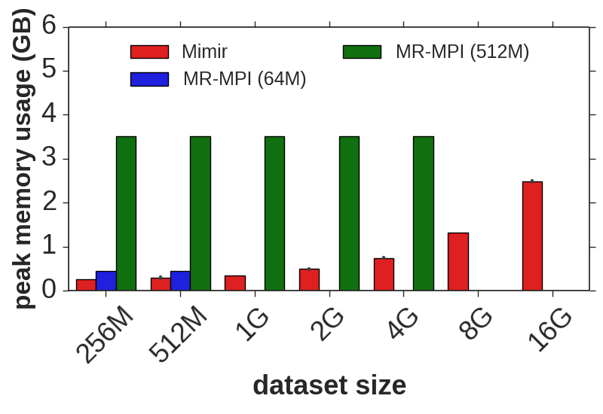
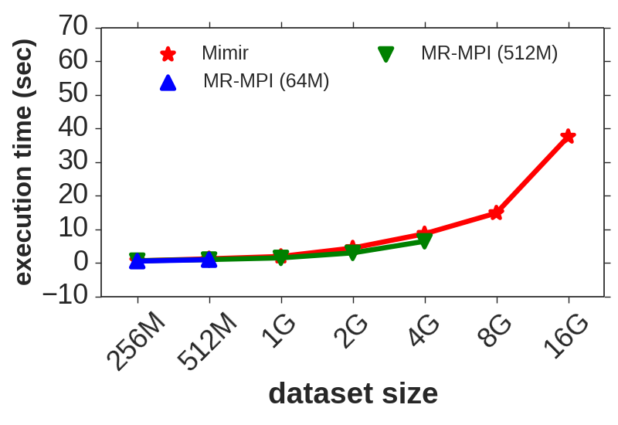
Mimir vs. MR-MPI: WC on Comet
Introduction Background Design Evaluation Conclusion
Single-node execution (24 processes, 128G memory)
Benchmarks: WC with Wikipedia dataset
Settings: MR-MPI (64M page and 512M page); Mimir (64M page)
4X
64X
Mimir can handle 4X larger dataset

Slide 18
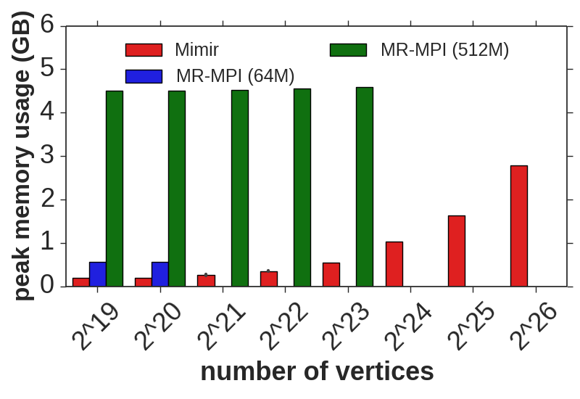
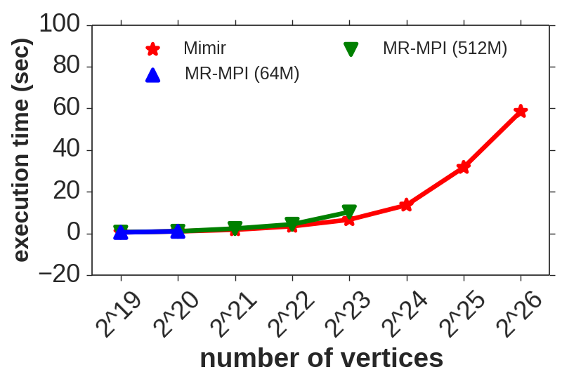
Mimir vs. MR-MPI: BFS on Comet
Introduction Background Design Evaluation Conclusion
Single-node execution (24 processes, 128G memory)
Benchmarks: BFS with Graph500 dataset
Settings: MR-MPI (64M page and 512M page); Mimir (64M page)
8X
Mimir can handle 8X larger dataset

Slide 19
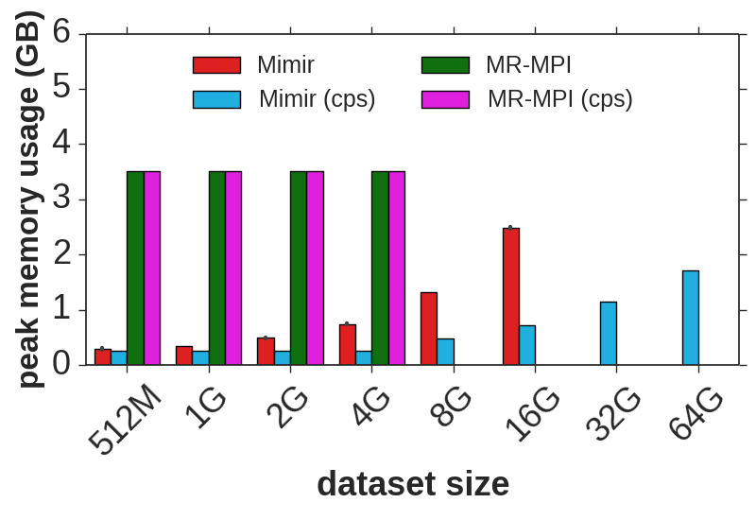
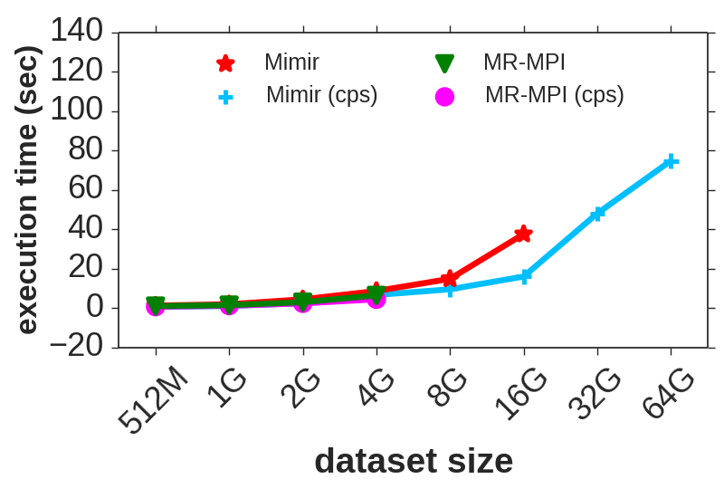
Mimir vs. MR-MPI: WC on Comet
Introduction Background Design Evaluation Conclusion
Single-node execution (24 processes, 128G memory)
Benchmarks: WC with Wikipedia dataset;
Settings: MR-MPI (512M page); Mimir (64M page); compression (cps)
16X
Mimir with compression handles 16X larger dataset

Slide 20
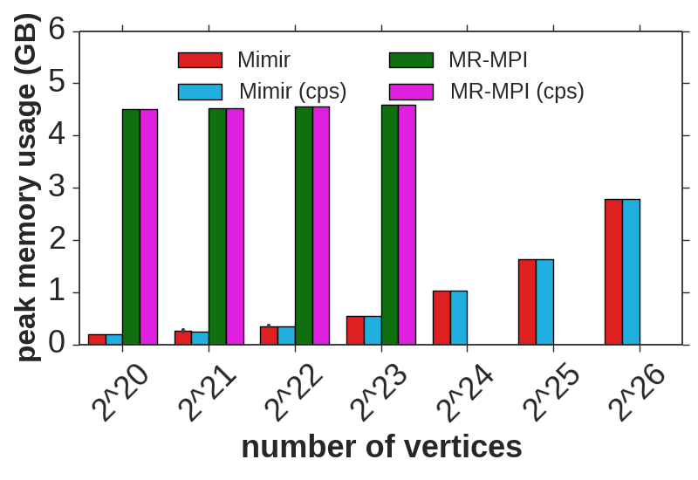
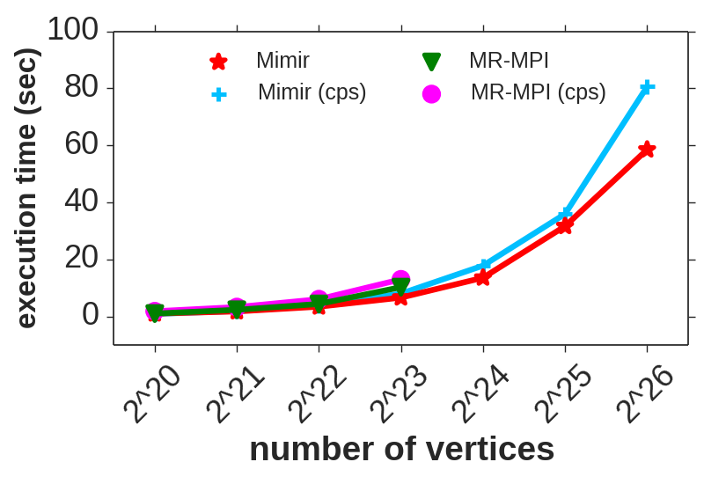
Mimir vs. MR-MPI: BFS on Comet
Introduction Background Design Evaluation Conclusion
Single-node execution (24 processes, 128G memory)
Benchmarks: BFS with Graph500 dataset
Settings: MR-MPI (512M page); Mimir (64M page); compression (cps)
8X
Mimir can handle 8X larger dataset

Slide 21
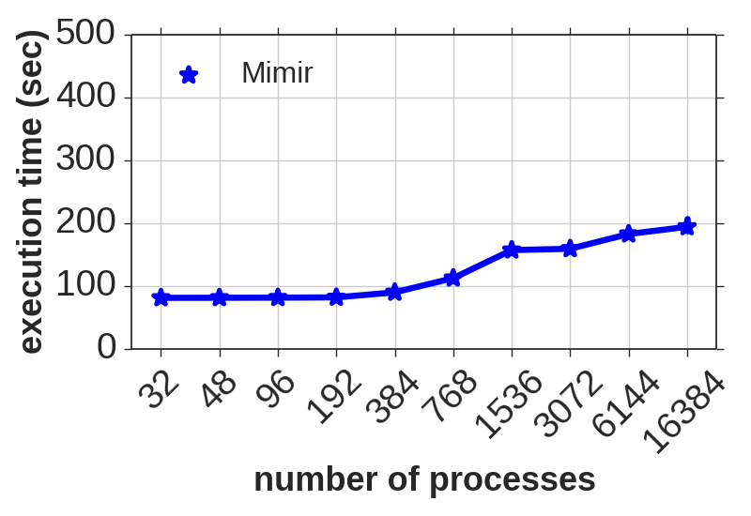
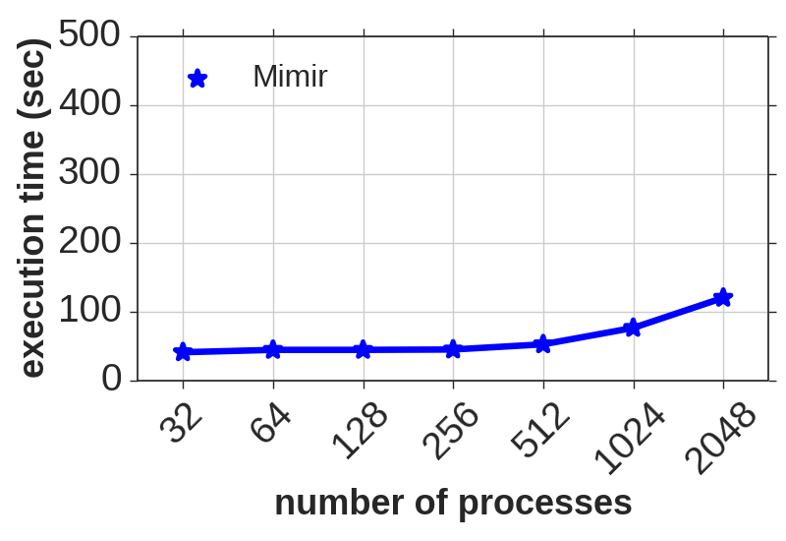
Mimir’s Scalability: WC on Mira
Introduction Background Design Evaluation Conclusion
Study the large-scale weak scalability (16 cores/node):
Benchmarks: WC with Synthetic dataset and Wikipedia dataset
Settings: Mimir (64M page), 16 processes/node
WC (Synthetic, 128M/proc)
WC (Wikipedia, 128M/proc)
The Wikipedia dataset does not have more data.
Mimir scales to 16,384 processes
Notes:
We have proven that Mimir performs better than MR-MPI, so we leave MR-MPI behind. Now we challenge Mimir and see how far it can go.

Slide 22
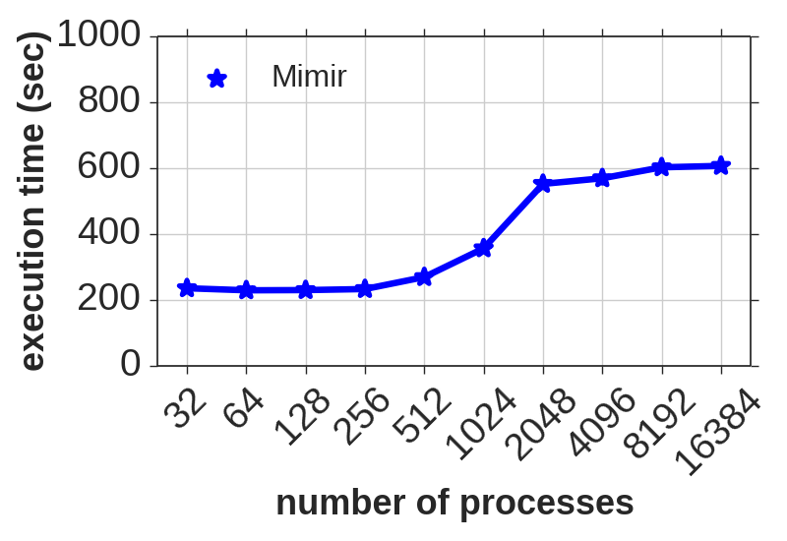
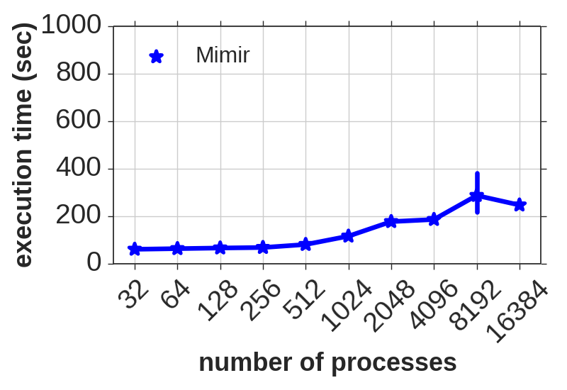
Mimir’s Scalability: OC and BFS on Mira
Introduction Background Design Evaluation Conclusion
Study the large-scale weak scalability (16 cores/node):
Benchmarks: OC and BFS
Settings: Mimir (64M page), 16 processes/node
OC (2^23/proc)
BFS (2^18/proc)
Mimir scales to 16,384 processes
Notes:
We have proven that Mimir performs better than MR-MPI, so we leave MR-MPI behind. Now we challenge Mimir and see how far it can go.

Slide 23
Lessons Learned
Introduction Background Design Evaluation Conclusion
We present a memory-efficient and scalable MapReduce over MPI
Mimir uses memory more efficiently compared with MR-MPI
Handle 16 times larger dataset in-memory compared with MR-MPI
Mimir is scalable to large number of processes
Scale to at least 16,384 processes
Mimir is a open-source software (experimental)
https://github.com/TauferLab/Mimir.git
Welcome to try out with your applications!

